Slide 1

CURRENT SCENARIO OF UWM IN KERALA
By,
Nandhitha R Krishnan
Suchitwa Mission

Slide 2

WASTEWATER GENERATION
Water demand:
  135 LPCD (Rural area)
  150 LPCD (Urban area)
Waste water generation (sewage) : 80% of water consumption
Eg: For 135 LPCD, Used water (sewage) generation= 135x0.8=108 LPCD
Black water: Grey water≈30:70 (32.4:75.6)

Slide 3

TERMINOLOGY
Blackwater & Greywater
Sewage & Feacal Sludge
Sewage treatment plant (STP)
Feacal Sludge Treatment Plant (FSTP)
Mobile FSTP
Packaged STP
GreyWater Treatment Plant (GWTP)
TREATMENT OPTIONS

Slide 4
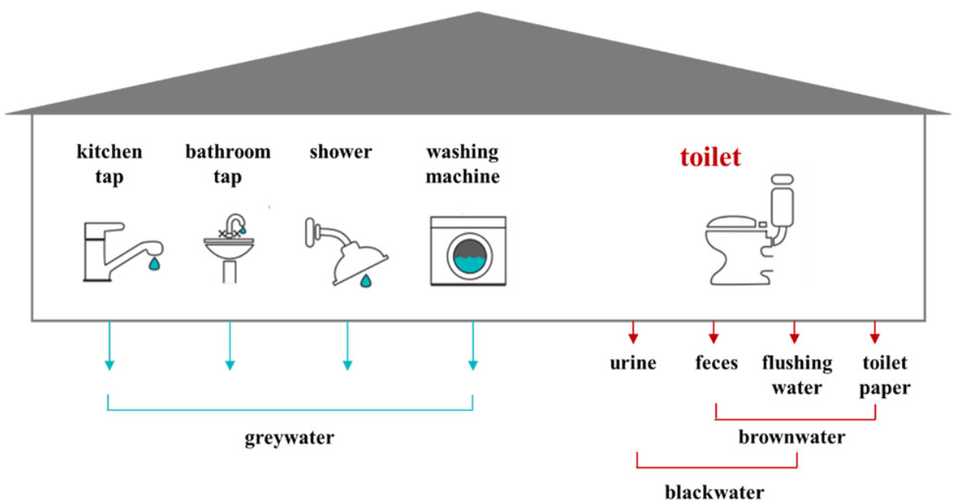
BLACKWATER V/S GREYWATER

Slide 5
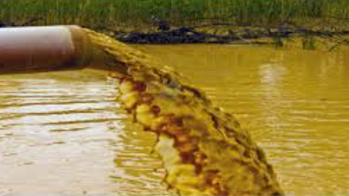
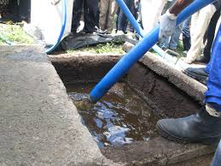
SEWAGE V/S SEPTAGE
SEWAGE
FEACAL SLUDGE / SEPTAGE
Mixture of feacal matter and water
(Blackwater + Greywater)
Slurry that results from storage/treatment of feacal matter

Slide 6

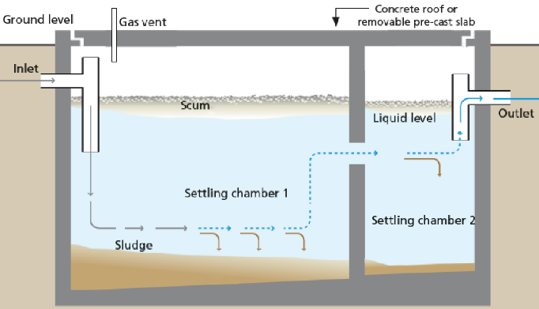
HIGH SEPTIC TANK/PITS RELIANCE
Kerala’s scenario: HIGH RELIANCE ON ON-SITE TREATMENT SYSTEMS
High dependence on pits, septic tank and soak pit for wastewater management
Feacal sludge generation (in KLD)
= 0.00021 x Population

Slide 7
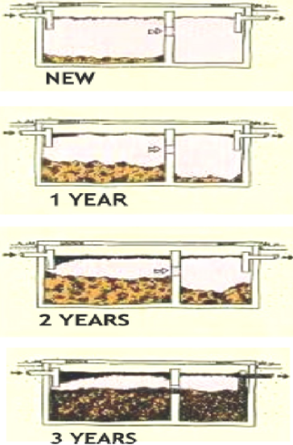
IMPORTANCE OF DESLUDGING OF SEPTIC TANK
Only about 30% of the settled solids are anaerobically digested in a septic tank.
Tanks needs cleaning when,
Sum of the depth of the scum and the sludge > (depth of the tank)/2
A portion of sludge not less than 25 mm in depth should be left behind in the tank bottom which acts as the seeding material for the fresh deposits.

Slide 8
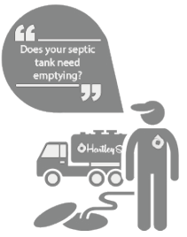
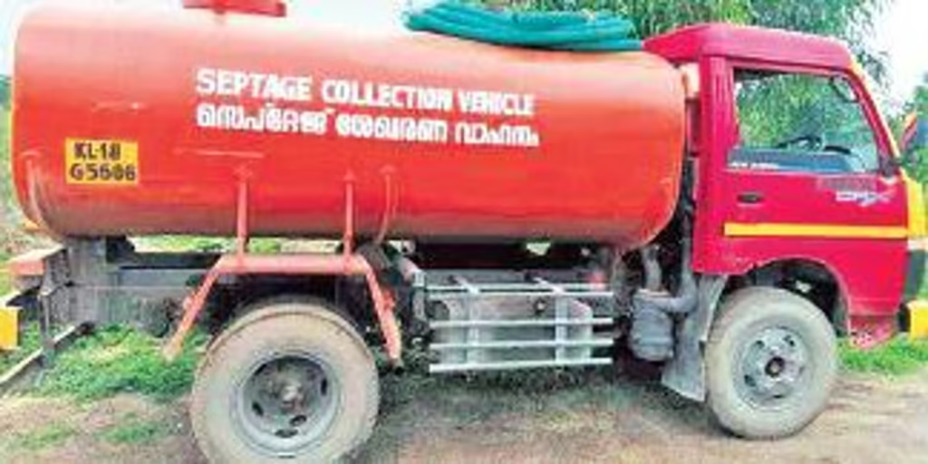
DESLUDGING AND TRANSPORTATION VEHICLE
Large volume transport for road width more than 3 m
Capacity = 2000 - 6000 L

Slide 9
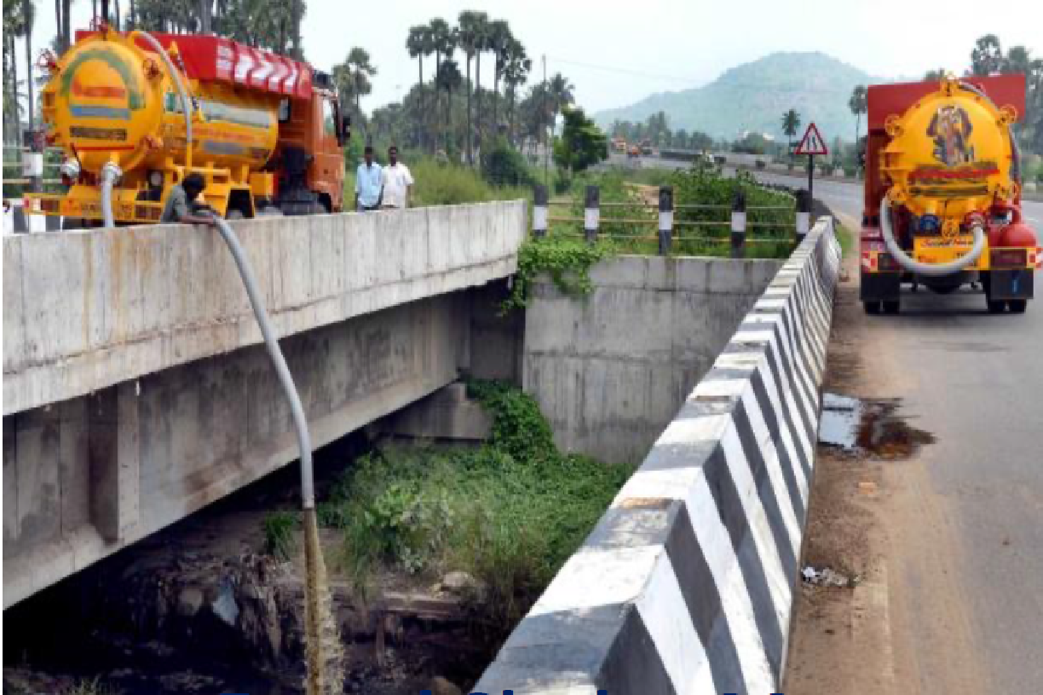
IMPROPER MANAGEMENT OF FEACAL SLUDGE
Improper dumping of desludged feacal sludge occurs:
Due to shortage of sufficient number of FSTPs (treatment facilities)
Contaminates water bodies
Creates public nuisance and health hazards

Slide 10
EXISTING WW TREATMENT FACILITIES IN KERALA
Sl. No | Existing STP (Network STP) | Existing FSTP
1 | 107 MLD plant at MUTTATHARA, THIRUVANANTHAPURAM | BRAHMAPURAM and WELLINGTON Plants in Kochi Corporation (100 KLD)
2 | 5 MLD plant at ELAMKULAM, ERNAKULAM | KALPETTA Municipality & MADAKKATHARA GP (10 KLD)
3 | 1 MLD plant at PADANNAPALAM, KANNUR | CHERTHALA FSTP (250 KLD) (Ongoing)

Slide 11
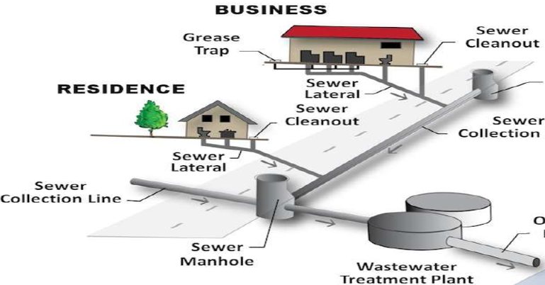
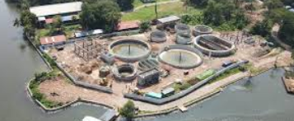
NETWORK STP IN CORE CITY AREA
NETWORK STP

Slide 12
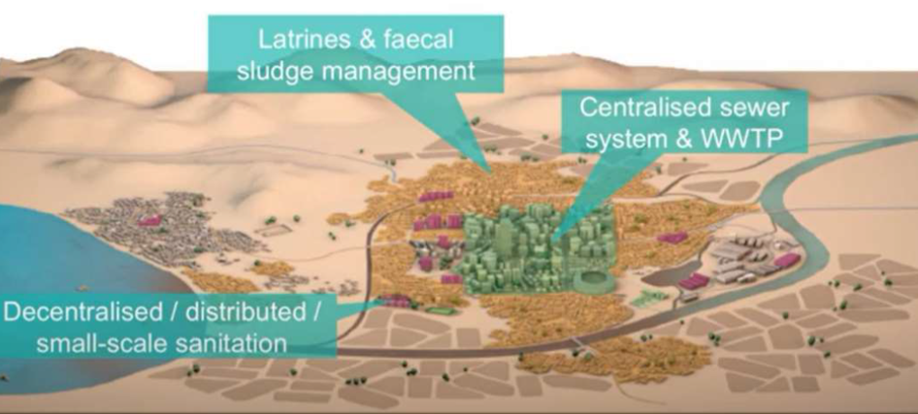
UWM APPROACH FOR AN AREA

Slide 13
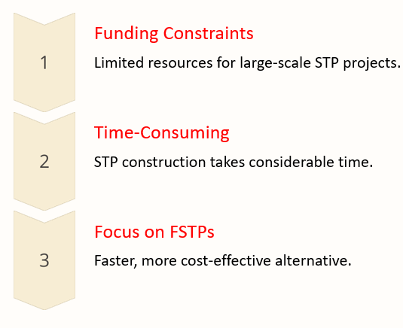
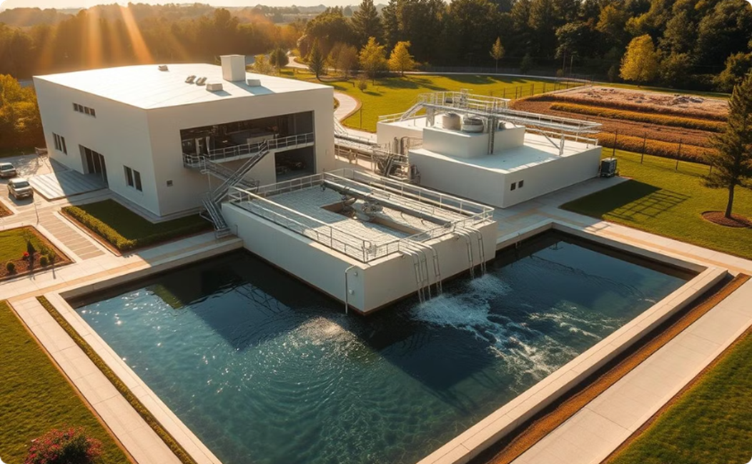
CONSTRAINTS IN IMPLEMENTING STP

Slide 14
POPULATION V/S WW GENERATION IN KERALA
2011 census population = 3,34,06,061
Projected population for 2024 = 3,56,40,084
Based on per-capita demand,
Type | Rural | Urban | Total
Black water (MLD) | 894 | 306 | 1200
Greywater (MLD) | 2086 | 713 | 2799
Total WW (MLD) | 2980 | 1019 | 3999

Slide 15
BLACKWATER GENERATION VS GAP
Parameters |  |  | Rural | Urban | Institutional STPs | Total
Blackwater Generation (MLD) |  |  | 894 | 306 |  | 1200
Existing STP Capacity (MLD) |  |  | 8.72 | 130.06 | 96 | 235
Ongoing and Proposed Capacity (MLD) |  |  | 0.59 | 107.68 |  | 108
Total STP Capacity (MLD) |  |  | 9.31 | 237.73 | 96 | 343
Among That,
Sewage Treatment Capacity (30% of STP) MLD |  |  | 3 | 71 | 29 | 103
GAP in Blackwater Treatment (MLD) |  |  | 891 | 206 |  | 1097

Slide 16
INFERENCE FOR WASTEWATER MANAGEMENT
In order to treat the above gap of 1097 MLD, we are depending upon the septic tank - soak pit system (on-site treatment systems)
Thus additional STPs (network STPs in CSZ and institutional STPs) have to be implemented.
In non-feasible areas, FSTPs may be proposed.
Urban sullage is being managed by the existing STPs and new community level Greywater systems are to be planned (Packaged GWM units and other GWM treatment options etc)

Slide 17
FEACAL SLUDGE MANAGEMENT
State has focused to setup FSTPs due to unique geography, settlement pattern etc
Treating 1 MLD of sewage is equivalent to treating 6.48 KLD of faecal sludge
FSTP - Clustering approach
Transported by ‘septage collection truck’
  maximum clustering radius = 15 km
Feacal sludge generation (in KLD)
= 0.00021 x Population
According to Kerala’s population, we require a capacity of 8 MLD FSTPs
The existing FSTPs are insufficient for handling Feacal sludge
Additional FSTPs are necessary to be planned at suitable locations

Slide 18
INFERENCE FOR WASTEWATER MANAGEMENT
Mobile Treatment Units are also being used by some local bodies. Demand based treatment can be managed by MTUs
In the flood prone areas Biodigestor facility is recommended.
Based on the Ground water table level, construction of twin pit toilet in the High land is being promoted.

Slide 19
Heavy reliance on septic tanks & soak pits, therefore, there are chances of groundwater contamination. About this no clarification is given:
Considering Kerala’s geography and land constraints, it is difficult to set up network STPs. Still State is trying to setup Network STPs in core sanitation areas of ULBs
State has declared as ODF indicating access to toilet for all. Hence as the forward linkage state is planning to set up FSTPs wherever STPs are not feasible
State is planning to set up Packaged STPs, Underground STPs, where there is land constraint
MTUs are being procured to avoid discharge of untreated sewage to water bodies

Slide 20


